Slide 1
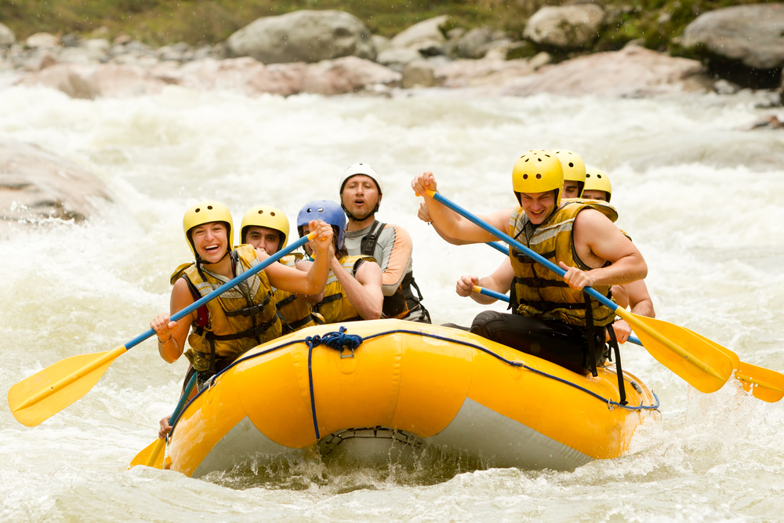



UNIT 6
ADVENTURES
We are going to learn:
Expressing Preferences
DAHA FAZLA BU TARZ ETKİNLİK İÇİN THE CHAMPION KİTABIMIZIN AKILLI TAHTA UYGULAMASINI altinkarne.com SİTEMİZDEN ÜCRETSİZ İNDİREBİLİRSİNİZ.

Slide 2


COMMON EXPRESSIONS
UNIT QUESTIONS
They are the apple of Turkish Air Force’s eye. Onlar Türk Hava Kuvvetleri’nin göz bebeği.
It seems dangerous. Tehlikeli görünüyor.
It requires a lot of courage. Çok fazla cesaret gerektiriyor.
It is one of the most exciting activities. O en heyecan verici aktivitelerden biridir.
Which one do you prefer doing on winter holidays? Kış tatillerinde hangisini yapmayı tercih edersin?
You can try it both abroad and Turkey. Onu hem Türkiye’de hem de yurtdışında deneyebilirsin.
I think rafting is more amusing than canoeing. Bence rafting kanoculuktan daha eğlenceli.
I would rather go rafting because it is easier. Raftinge gitmeyi tercih ederim çünkü o daha kolay.
You can do it individually or as a group. Onu hem bireysel hem de grup olarak yapabilirsin.
My uncle is fond of adventure. Amcam maceraya düşkündür.
He can survive in nature on his own. O doğada kendi başına hayatta kalabilir.
What do you prefer doing on your summer holidays? Yaz tatillerinde ne yapmayı tercih edersin?
Why do you prefer it? Onu neden tercih edersin?
What do you need for this sport? Bu spor için neye ihtiyacın var?
Who takes the most risk? En çok riski kim alır?
What are their professions? Onların mesleği ne?
Do you know any adventurer? Hiç maceracı tanıyor musun?
What is the aim of it? Onun amacı ne?
How can you describe their job? Onların mesleğini nasıl tanımlarsın?
Which extreme sport do you prefer? Hangi ekstrem sporu tercih edersin?

Slide 3


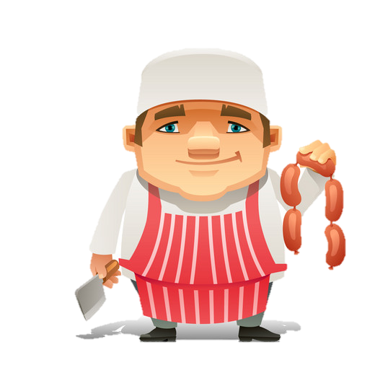
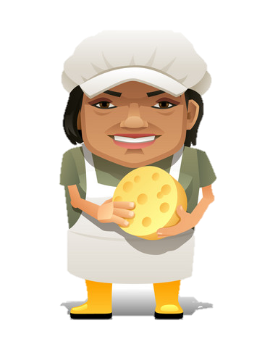
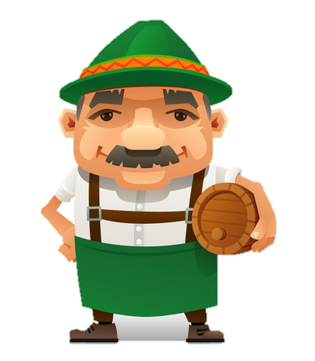
EXTREME SPORTS
PROFESSIONS
farmer çiftçi
teacher öğretmen
electrician elektrikçi
police officer polis memuru
window cleaner pencere temizleyici
stuntman dublör
astronaut astronot
coal miner madenci
fire fighter itfaiyeci
air traffic controller hava trafiği kontrolcüsü
call center specialist çağrı merkezi uzmanı
dietician diyetisyen
fighter pilot savaş pilotu
instructor eğitmen
scientist bilim adamı
squadron commander hava filosu kumandanı
rafting rafting
kayaking su kayağı
skydiving serbest paraşüt
indoor skydiving kapalı mekan serbest paraşüt
scuba diving tüplü dalış
canoeing kanoculuk
paragliding yamaç paraşütü
hang-gliding delta kanat sporu
skateboarding kaykay yapma
motor-racing motor/araba yarışı
mountain-biking dağ bisikleti
rock climbing kaya tırmanışı
caving mağaracılık / mağara sporu
NOUN & ADJECTIVE PHRASES
extreme sport ekstrem spor
free fall serbest düşüş
age range yaş aralığı
finish line bitiş çizgisi
aircraft industry uçak endüstrisi
all-inclusive her şey dahil weather condition hava durumu

Slide 4

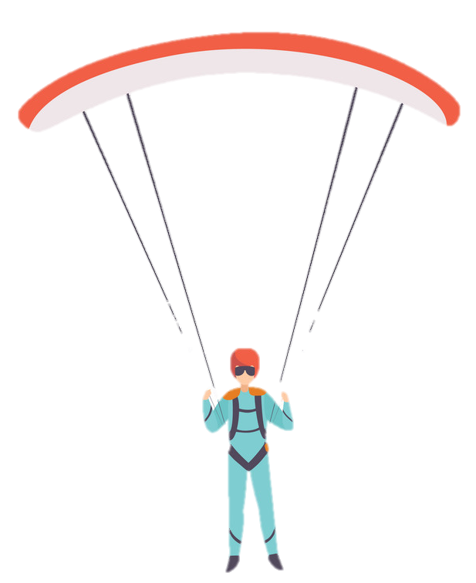
  ADJECTIVES
amusing eğlenceli
boring sıkıcı
challenging zorlu
disappointing hayal kırıklığına uğratıcı
entertaining eğlenceli
exciting heyecan verici
fascinating büyüleyici
interesting ilginç
risky riskli
nervous gergin
afraid korkmuş
experienced tecrübeli
inexperienced tecrübesiz
adventurous maceralı
amazing şaşırtıcı
easy kolay
dangerous tehlikeli
mysterious gizemli
popular popüler
comfortable rahat
ambitious hırslı
fearless korkusuz
scientific bilimsel
stressful stresli
magnificent büyüleyici
wonderful müthiş
great büyük
outdoor açık hava
indoor kapalı mekan
aerobatic hava akrobasisi
acrobatic akrobatik
included dahil
VERBS
fly uçmak
succeed başarmak
perform gösteri yapmak / yapmak
explore keşfetmek
need ihtiyaç duymak
require gerekmek / gerektirmek
wear giymek
check kontrol etmek
carry taşımak
seem görünmek
experience tecrübe etmek / deneyimlemek
try denemek
improve geliştirmek
break kırmak
survive hayatta kalmak
reach ulaşmak
protect korumak
describe betimlemek / tanımlamak
become olmak
move hareket etmek
produce üretmek
land iniş yapmak
vary çeşitlilik göstermek

Slide 5
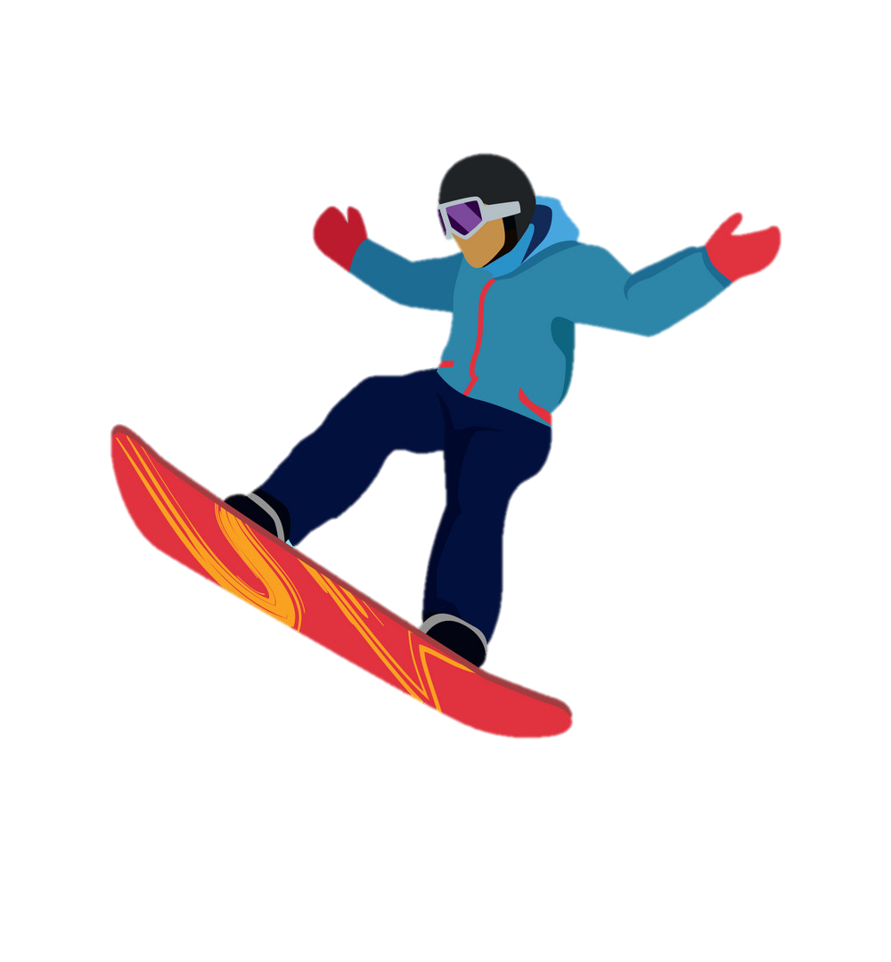
  NOUNS
member üye
person insan
location yer
transportation taşıma
demonstration gösteri
speed hız
distance mesafe
experience tecrübe / deneyim
abroad yurt dışı
profession meslek
view manzara
land kara
century yüzyıl
courage cesaret
adrenaline adrenalin
backup yedek
plane uçak
movement hareket
wind rüzgar
accident kaza
adventurer maceracı
fall düşüş
importance önem
success başarı
bravery cesaret
occupation meslek
nature doğa
catering yeme içme
accommodation konaklama
pair çift
track pist
aim amaç
district bölge
ADJECTIVES
helmet kask
paddle kısa kürek
dry-suit vücudu kuru tutan dalgıç kıyafeti
wetsuit dalgıç giysisi
skateboard kaykay
elbow pad dirsek koruyucu
knee pad dizlik
kayak kano
life jacket can yeleği
clothing giysi
footwear ayakkabı
sock çorap
glove eldiven
torch el feneri
cave pack mağara çantası
bootie patik, kısa bot
raft sal
wing kanat
flight suit uçuş takımı / giysisi
parachute paraşüt
armour zırh
goggles gözlük
wrist guard bilek koruyucu
flight instrument uçuş aleti

Slide 6
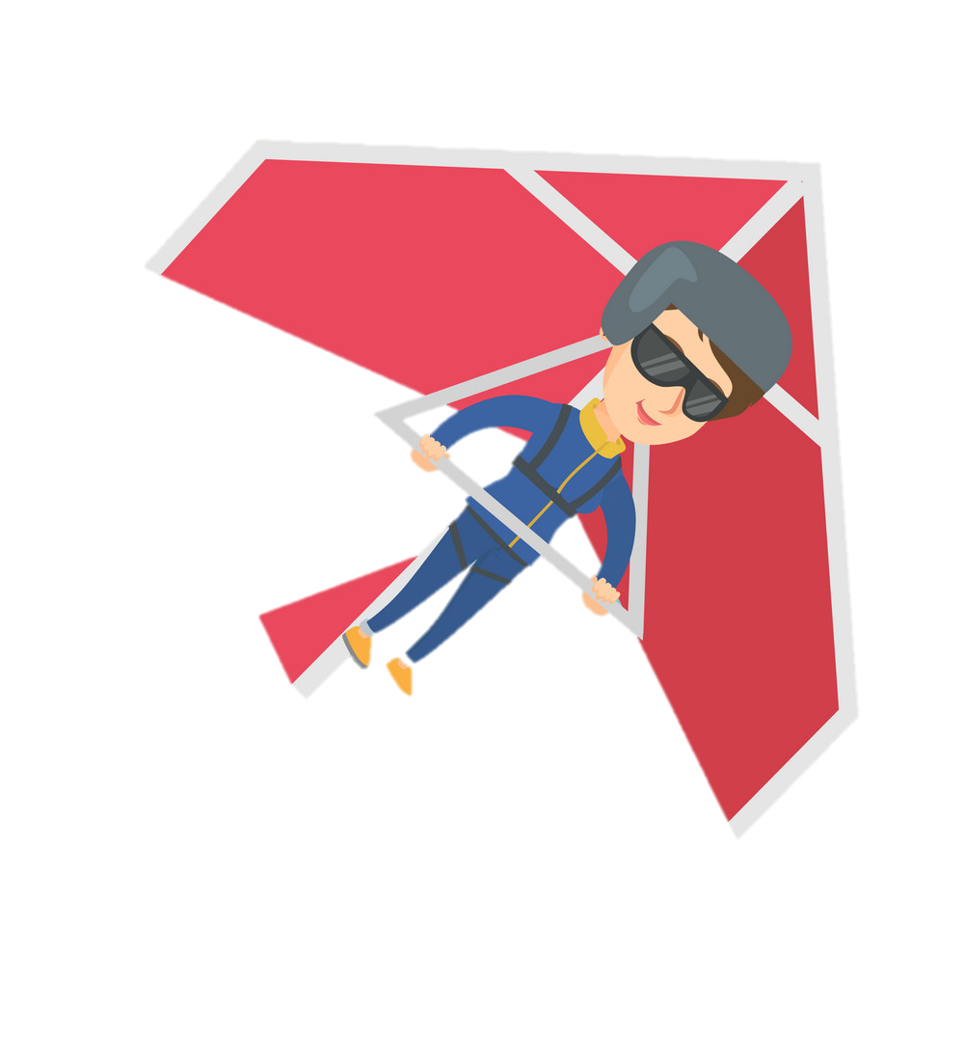

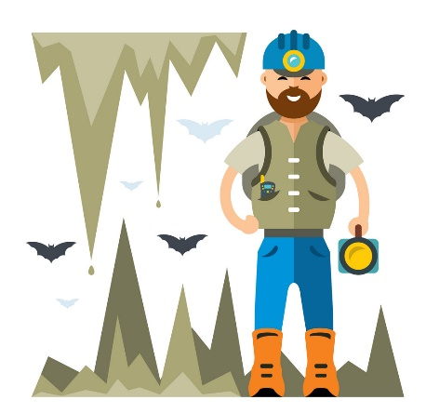

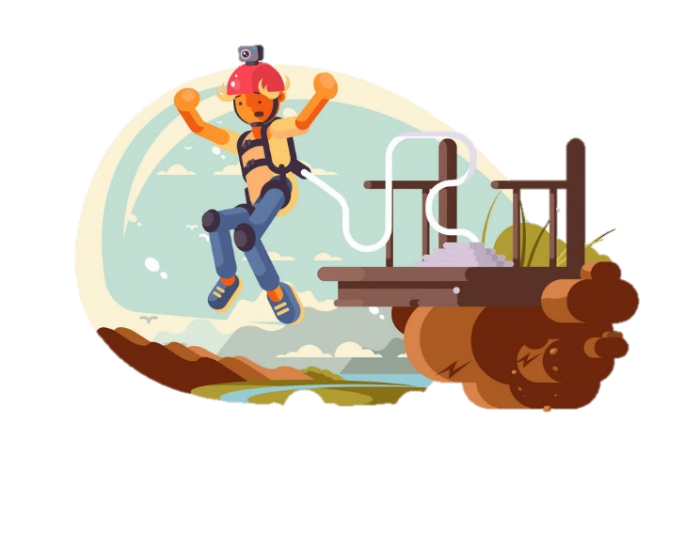

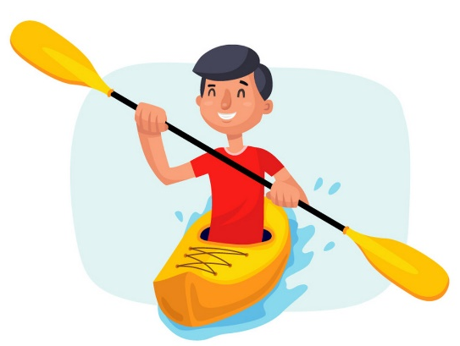
Vocabulary Exercises
2. Complete the sentences with the words below.
1. Write the words under the pictures.
brave
comfortable
aerobatic
avoid
kayaking
bungee-jumping
skydiving
mysterious
personal
afraid
boring
hang-gliding
caving
scuba-diving
1. You have to be ________________ to become a skydiver because jumping out of a plane requires a lot of courage.
2. The crowd was entertained with the ______________ demonstration of the squadron.
3. This bed is so _______________ that I don’t want to get up.
4. To me, golf is a _______________ sport so I don’t like it.
5. My favorite summer activity is going caving. Exploring ____________ places makes me feel excited.
6. I have acrophobia. I feel _______________ and nervous when I go high.
brave
1.
3.
2.
Nartest İngilizce
aerobatic
caving
hang-gliding
scuba-diving
___________
___________
___________
6.
comfortable
4.
5.
boring
mysterious
kayaking
bungee-jumping
skydiving
___________
___________
___________
afraid

Slide 7
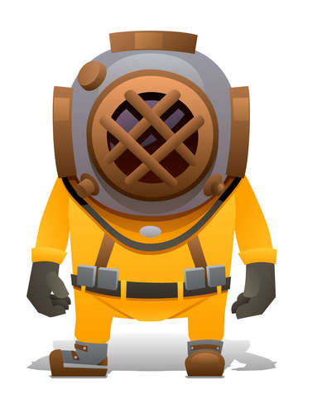
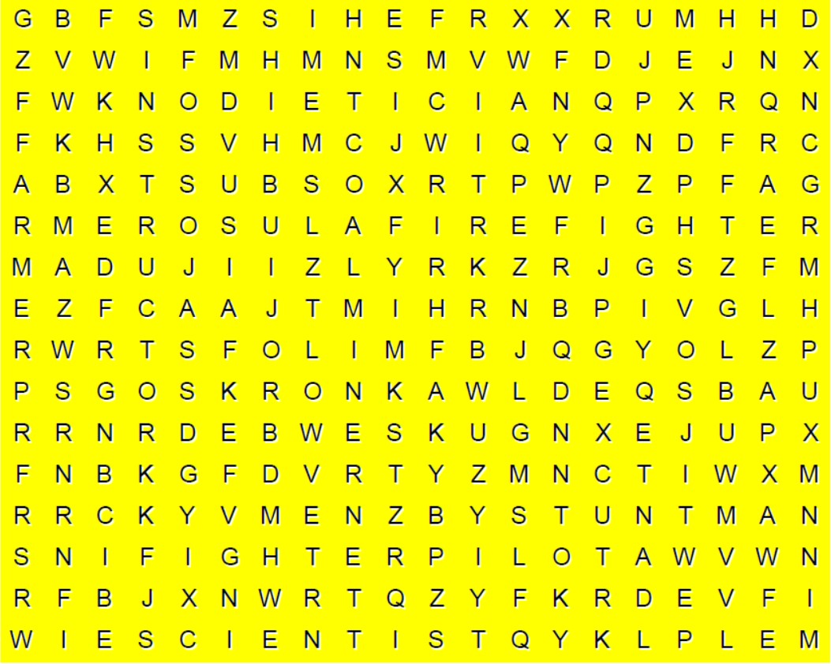

3. Match the halves of the phrases.
5. Find the 8 words in the word-search puzzle below.
7.
1. extreme ___ a) industry
2. free ___ b) line
3. age ___ c) skydiving
4. finish ___ d) condition
5. indoor ___ e) sport
6. weather ___ f) fall
7. aircraft ___ g) range
4.
5.
6.
1.
2.
3.
Nartest İngilizce
4. Circle the correct options to complete the sentences.
1. I do sport every morning to become / vary healthier.
2. The aim of the motor-racing is to perform / reach the finish line.
3. Skydivers use their parachutes to protect / slow down in a free fall.
4. He broke / tried 6 world records and became famous in the world.
5. Extreme sports require / seem very dangerous to me so I am not fond of them.
6. We feel very nervous and excited when we lie to someone because our body produces / carries a hormone called adrenaline.

Slide 8
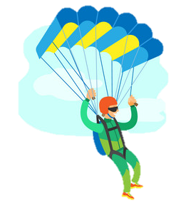
GRAMMAR
Expressing Preferences
When we talk about our preferences we use ‘prefer’ and ‘would rather’.
Prefer
Positive
Negative
I We You They | prefer | skydiving going skydiving | to | paragliding.
He She It | prefers
I We You They | don’t prefer | skydiving going skydiving | to | paragliding.
He She It | doesn’t prefer
Question
Short Answers
Do | I we you they | prefer | skydiving going skydiving | to | rock climbing?
Does | he she it
Yes, I do. / No, I don’t. Yes, you do. / No, you don’t. Yes, we do. / No, we don’t. Yes, they do. / No, they don’t.
Yes, he does. / No, he doesn’t. Yes, she does. / No, she doesn’t. Yes, it does. / No, it doesn’t.

Slide 9
Would rather
Positive
Negative
I We You They He She It | would rather | go scuba diving | than | canoeing.
I We You They He She It | would rather not | go skateboarding | than | kayaking.
Question
Short Answers
Would | I we you they he she it | rather | go rafting | than | paragliding?
Yes, I would. / No, I wouldn’t. Yes, you would. / No, you wouldn’t. Yes, we would. / No, we wouldn’t. Yes, they would. / No, they wouldn’t. Yes, he would. / No, he wouldn’t. Yes, she would. / No, she wouldn’t. Yes, it would. / No, it wouldn’t.

Slide 10
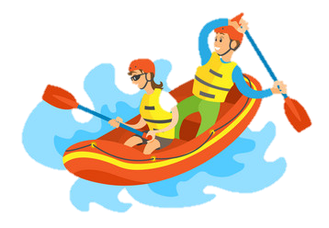
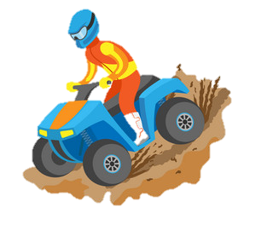
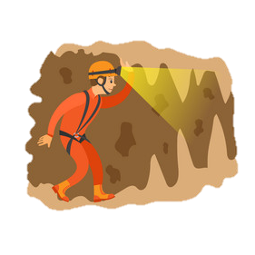
EXERCISES
1. Circle the correct options to complete the sentences.
1. Will : Which one do / would you prefer? Skydiving or bungee-jumping?
Jim : I would rather / prefer going skydiving to bungee-jumping because it is more exciting.
2. Drake : What do you prefers/ prefer doing on your summer holidays?
Zach : I prefer / would rather go paragliding because it is very adventurous.
3. I usually prefer go / going scuba diving to paragliding because it is more entertaining.
4. Most people generally prefer / would rather skydiving to other extreme sports.
5. My buddies and I prefer / would rather go rafting in summers.

Slide 11
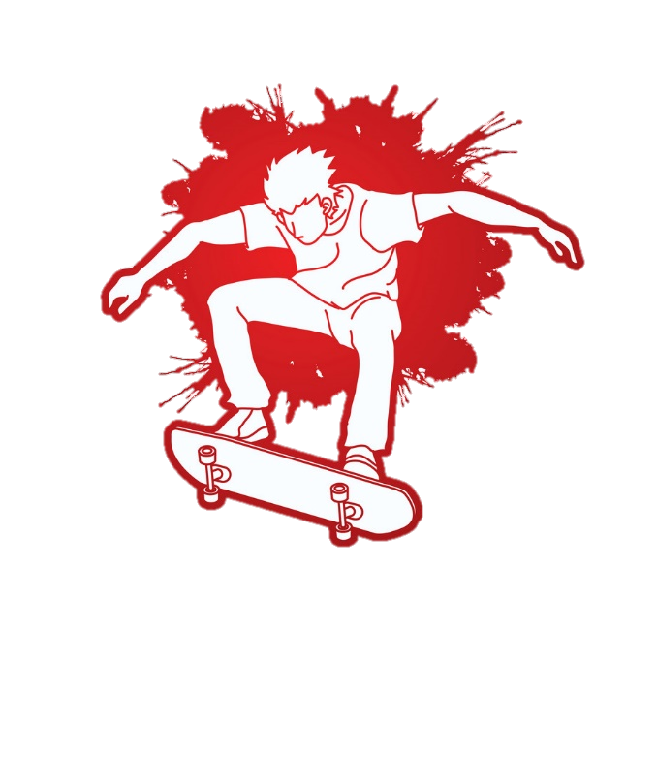
2.Put the sentences into the correct order.
1. rafting / prefers / Tina / caving to.
____________________________________________
2. rather / Yuka / go / caving than / skydiving / would.
______________________________________ ____________
3. prefer / you / what / do / in summers / doing?
______________________________________
4. camping / Sheila / going / prefers / her friends / with.
______________________________________
5. would / Brad / do / sports / rather / indoor.
______________________________________
6. rather / she / skydiving / go / would?
______________________________________ .
7. going / doesn’t / he / prefer / paragliding.
______________________________________ .
3. Find and correct the mistakes in the sentences below.
Tina prefers caving to rafting.
1. David would rather going hang-gliding.
_________________________________________
2. What does she prefers doing in summers?
_________________________________________
3. Amy would rather play golf to go rafting. _________________________________________
4. They doesn’t prefer doing indoor sports.
_________________________________________
5. I prefer go kayaking to canoeing.
_________________________________________
Yuka would rather go caving than skydiving.
go
What do you prefer doing in summers?
Nartest İngilizce
prefer
Sheila prefers going camping with her friends.
than
Brad would rather do indoor sports.
don’t
Would she rather go skydiving?
going
He doesn’t prefer going paragliding.

Slide 12

NARTEST İNGİLİZCE KALİTESİNE DAHA FAZLA ULAŞMAK İÇİN
www.altinkarne.com Sitemizden Kitaplarımızın PDF hallerine, Akıllı Tahta Uygulamalarına ve Ücretsiz Birçok Dokümana Ulaşabilirsiniz.

