Slide 1
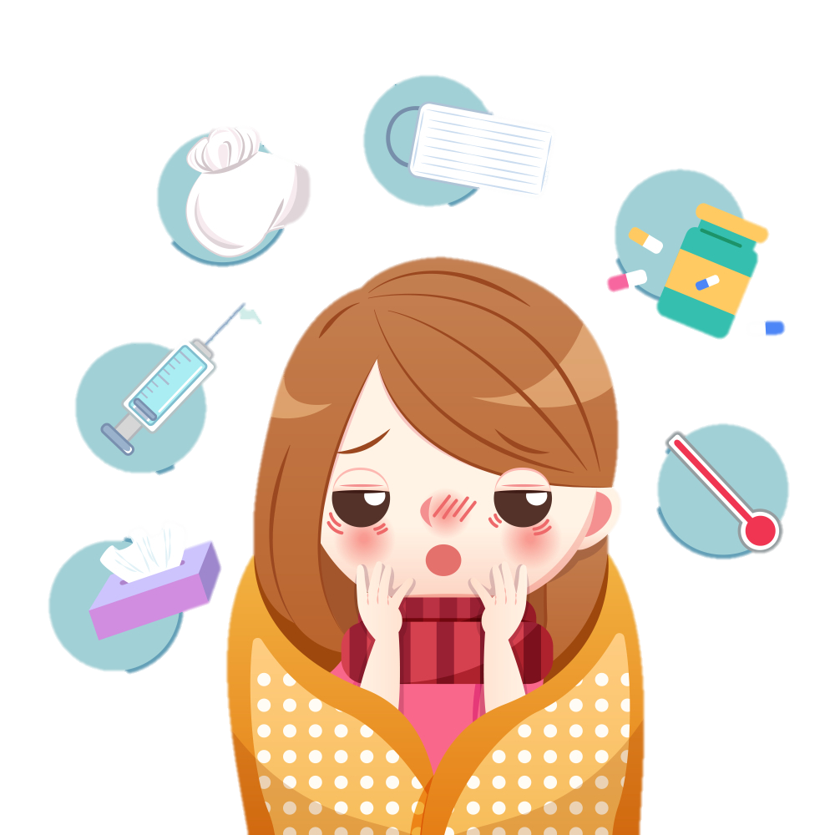
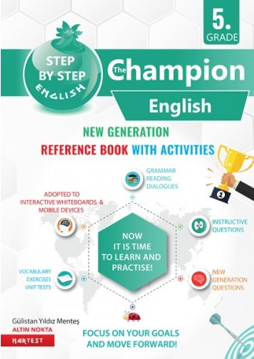
UNIT 5
HEALTH
We are going to learn:
Making simple suggestions
Expressing illnesses, needs and feelings
DAHA FAZLA BU TARZ ETKİNLİK İÇİN THE CHAMPION KİTABIMIZIN AKILLI TAHTA UYGULAMASINI altinkarne.com SİTEMİZDEN ÜCRETSİZ İNDİREBİLİRSİNİZ.

Slide 2
COMMON EXPRESSIONS
UNIT QUESTIONS
I feel cold. Üşüyorum.
I have the flu. Grip oldum.
I have a high fever. Ateşim var.
You have a sore throat. Senin boğaz ağrın var.
She feels cold and tired. O üşüyor ve yorgun.
She needs pills. İlaca ihtiyacı var.
You should stay in bed. Yatakta kalmalısın.
You should see a doctor. Bir doktora görünmelisin.
Have a rest. Dinlen.
Visit a doctor. Bir doktoru ziyaret et.
Take your pills. İlaçlarını al.
My leg is broken. Ayağım kırık.
It hurts a lot. Çok acıyor.
I have a pain in my stomach. Midemde bir ağrı var
Calm down, please. Sakin ol, lütfen.
I am sorry to hear that. Bunu duyduğuma üzüldüm.
Get well soon. Geçmiş olsun.
I have a terrible pain in my back. Belimde korkunç bir ağrı var.
Don’t drink cold water. Soğuk su içme.
What is the matter with you? Neyin var?
What’s the problem? Problem ne?
What is wrong with you? Neyin var?
Do you have a runny nose? Burnun akıyor mu?
What should she do? O ne yapmalı?
Are you alright? İyi misin?

Slide 3
VERBS
ILLNESSES AND HEALTH PROBLEMS
buy satın almak
hurt acımak
feel hissetmek
stay kalmak
drink içmek
eat yemek yemek
carry taşımak
hear duymak
need ihtiyaç duymak
wash yıkamak
arrive varmak
keep away uzak tutmak
have a rest dinlenmek
see a doctor doktora görünmek
see a dentist dişçiye görünmek
calm down sakin olmak
cough öksürük
fever ateş
stomachache mide / karın ağrısı
measles kızamık
headache baş ağrısı
backache sırt ağrısı
sore throat boğaz ağrısı
broken arm kırık kol
runny nose burun akıntısı
cold soğuk algınlığı
toothache diş ağrısı
flu grip

Slide 4
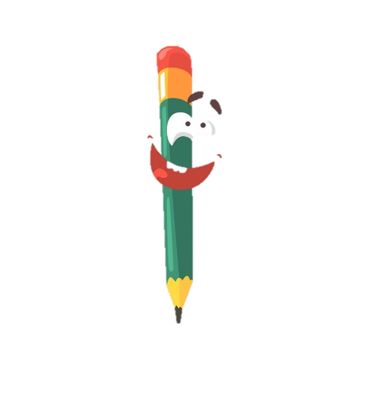
NOUNS
medicine ilaç
daughter kız çocuk
pain ağrı / acı
stomach mide, karın
arm kol
matter problem
pill hap
clinic klinik
syrup şurup
dentist dişçi
hospital hastane
pharmacy eczane
mint nane
patient hasta
tissue kağıt mendil
blanket peçete
fruit meyve
vegetable sebze
illness hastalık
thermometer termometre
candy şeker
water su
relative akraba
coke kola
skateboarding kaykay
exercise egzersiz
outside dışarı
nurse hemşire
ADJECTIVES
broken kırık
high yüksek
tired yorgun
terrible berbat
runny sulu / akan
heavy ağır
healthy sağlıklı
unhealthy sağlıksız
sorry üzgün
important önemli
alright iyi
bad kötü
outside dışardaki
faint baygın, halsiz

Slide 5
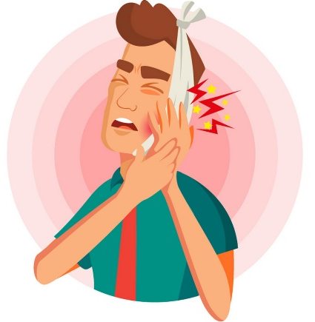
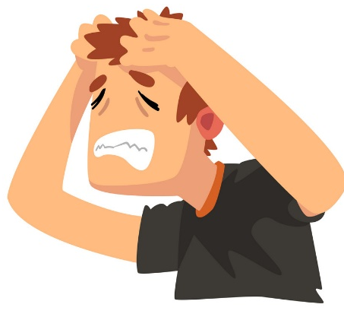
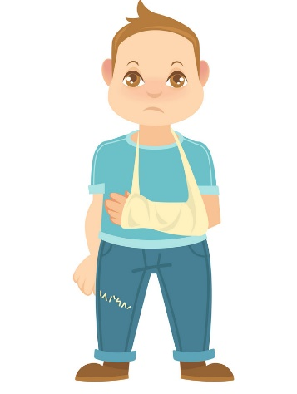
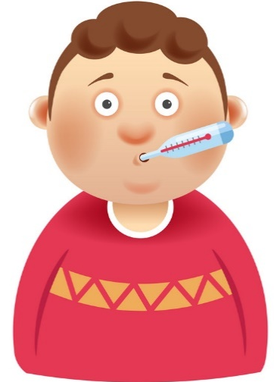
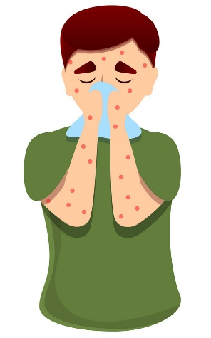
Vocabulary Exercises
1. Write the words under the pictures.
2. Complete the sentences with the words below.
cough
fever
measles
stay
drink
feel
needs
headache
toothache
broken arm
pills
matter
pain
runny
1.
3.
2.
1. You have the measles. You should __________ at home.
2. I don’t __________ alright. I have a backache.
3. You shouldn’t ___________ cold water in winter.
4. There is a terrible ___________ in my tooth.
5. Helen has a __________ nose. She has the flu.
6. What’s the __________ with you?
7. You should take your _________ daily to get well soon.
8. Melissa feels cold. She __________ a blanket.
stay
Nartest İngilizce
feel
drink
toothache
headache
broken arm
___________
___________
___________
5.
6.
pain
4.
runny
matter
measles
pills
cough
fever
___________
___________
___________
needs

Slide 6
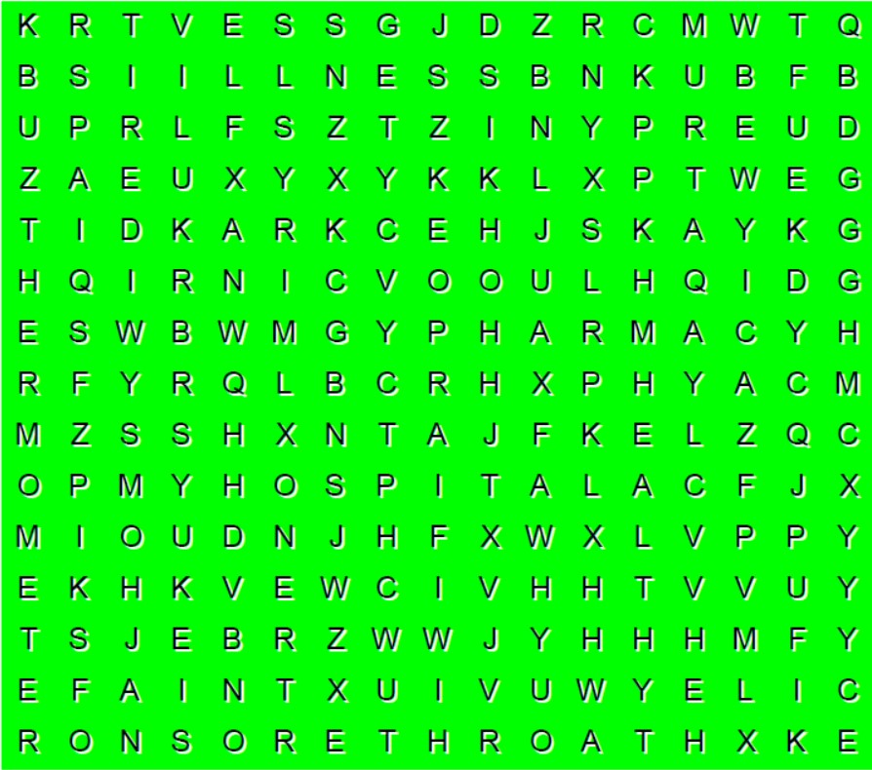
3. Match the sentences with their Turkish translations.
5. Find the 8 words in the word-search puzzle below.
7
1. Are you alright? ___ a) Grip oldum.
2. I am sorry to hear that. ___ b) Geçmiş olsun.
3. What’s wrong with you? ___ c) Ayağım kırık.
4. Get well soon. ___ d) Yatakta kalmalısın.
5. My leg is broken. ___ e) İyi misin?
6. You should stay in bed. ___ f) Bunu duyduğuma üzüldüm.
7. I have the flu. ___ g) Neyin var?
4
5
6
1
2
3
Nartest İngilizce
4. Circle the correct options to complete the sentences.
1. Derrick has a toothache / backache. He should see a dentist.
2. What’s the problem / wrong?
3. I have a runny nose / syrup.
4. Mark has a backache. He shouldn’t carry / eat heavy things.
5. You should hurt / wash your hands before and after dinner.
6. Calm down / away please.

Slide 7
GRAMMAR
Making Simple Suggestions
We use ‘should/shouldn’t’ and ‘imperatives’ to make suggestions.
Positive Form
Negative Form
Question Form
I We You They He She It | should | see a doctor.
I We You They He She It | shouldn’t | see a doctor.
Should | I we you they he she it | see a doctor?
Short Answers
Yes, I / we / you / they / he / she / it should. No, I / we / you / they / he / she / it shouldn’t.
Study the imperative sentences below.
Have a rest. Dinlen.
Don’t drink cold water. Soğuk su içme.
Visit a doctor. Doktora git.
Stay in bed. Yatakta kal.
Take your medicine. İlacını al.

Slide 8
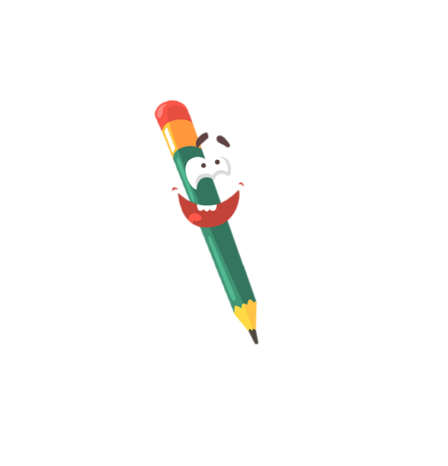
Expressing Ilnesses, Needs and Feelings
We use ‘ feel / feels, have / has’ to express our illnesses, health problems and feelings.
We use ‘need / needs’ to express our needs. Study the sentences below.
Examples
I need a blanket.
I don’t need a blanket.
You need a tissue.
He needs a medicine.
He doesn’t need medicine.
A: Do you need a blanket? B: Yes, I do.
A: Does she need a tissue? B: No, she doesn’t.
I feel cold.
She feels faint.
He feels tired.
I don’t feel alright.
She doesn’t feel well.
A: Do you feel alright? B: Yes, I do.
A: Does she feel faint? B: No, she doesn’t.
You have a fever.
He has a headache.
He doesn’t have a toothache.
I have the flu.
I don’t have a fever.
A: Do you have a sore throat? B: No, I don’t.
A: Does he have a headache? B: Yes, he does.

Slide 9
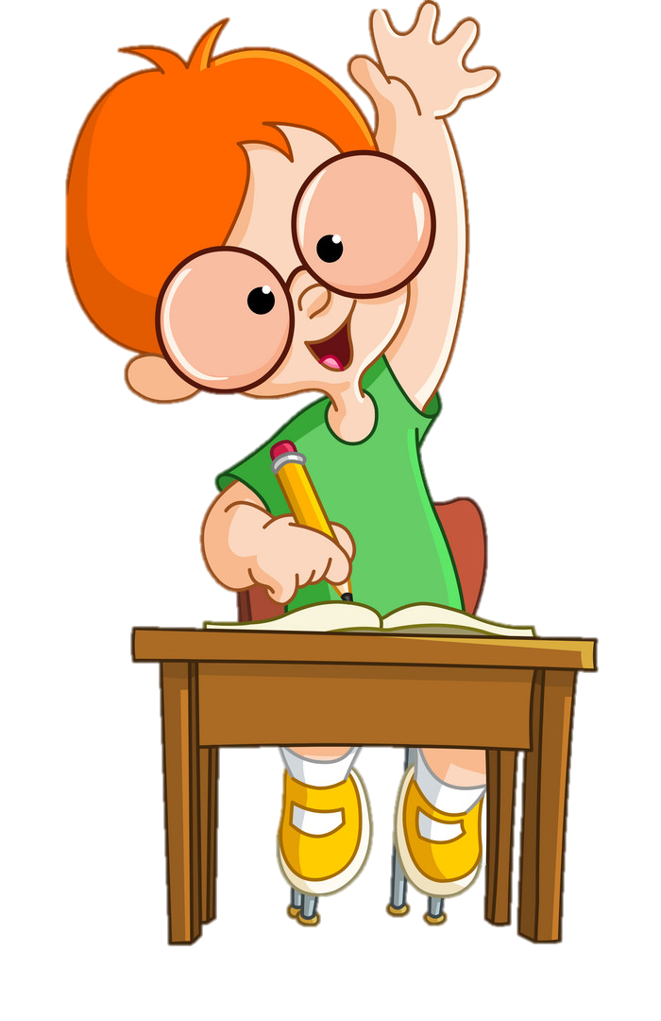
EXERCISES
1. Circle the correct options to fill in the blanks.
1. Marie : Does she feels / feel alright?
Lilly : No, she doesn’t / don’t. She is ill.
2. Zach : I think you should see / seeing a doctor.
3. Kim : Do you need / needs a blanket?
Mark : Yes, please. I feel / feeling cold.
4. Betty : Does / Do your sister have a fever?
Daisy : Yes, she does / do.

Slide 10
2.Put the sentences into the correct order.
1. drink / water / cold / don’t.
______________________________________
2. see / you / a / dentist / should.
______________________________________
3. has / Julia / throat / a / sore.
______________________________________
4. need / he / does / a / tissue?
______________________________________
5. doesn’t / alright / feel / she .
______________________________________
6. have / headache / you / a / do?
______________________________________
7. bed / in / stay.
______________________________________
3. Find and correct the mistakes in the sentences below.
Don’t drink cold water.
1. Philip have a cough.
_________________________________________
2. I doesn’t need a tissue.
_________________________________________
3. Does your friends have a backache?
_________________________________________
4. She should staying at home.
_________________________________________
5. Takes your medicine. _________________________________________
You should see a dentist.
has
Julia has a sore throat.
Nartest İngilizce
don’t
Does he need a tissue?
Do
She doesn’t feel alright.
stay
Do you have a headache?
Take
Stay in bed.

Slide 11
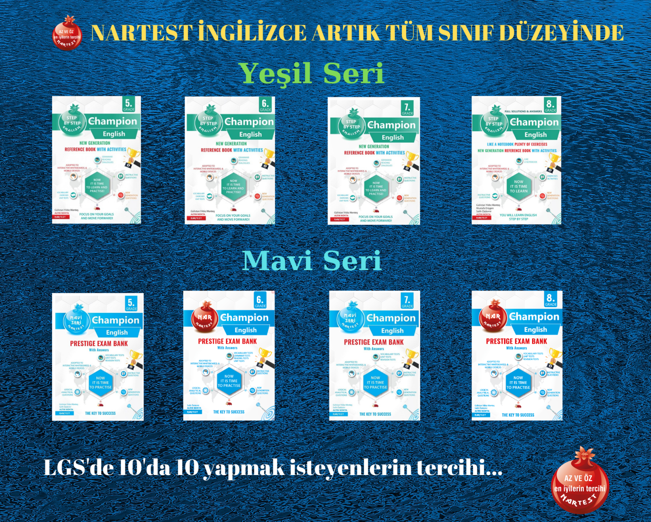
NARTEST İNGİLİZCE KALİTESİNE DAHA FAZLA ULAŞMAK İÇİN
www.altinkarne.com Sitemizden Kitaplarımızın PDF hallerine, Akıllı Tahta Uygulamalarına ve Ücretsiz Birçok Dokümana Ulaşabilirsiniz.

