Slide 1
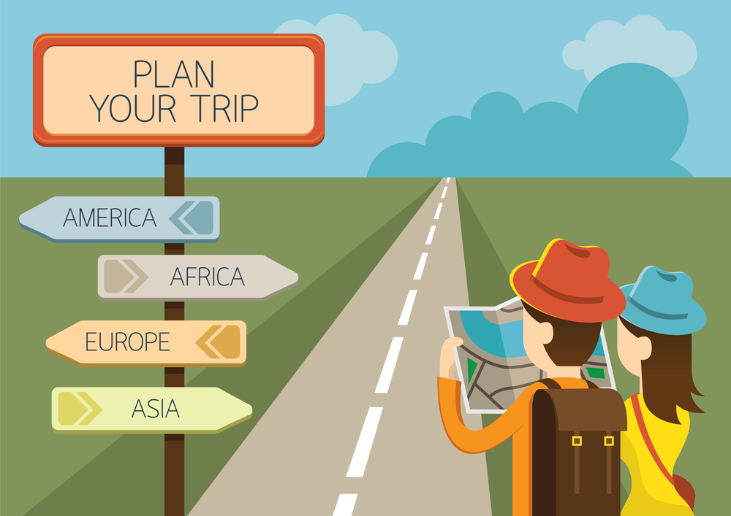



UNIT 7
TOURISM
We are going to learn:
Giving explanations and reasons
Making comparisons
DAHA FAZLA BU TARZ ETKİNLİK İÇİN THE CHAMPION KİTABIMIZIN AKILLI TAHTA UYGULAMASINI altinkarne.com SİTEMİZDEN ÜCRETSİZ İNDİREBİLİRSİNİZ.

Slide 2


COMMON EXPRESSIONS
UNIT QUESTIONS
I have been to the authentic city, Şanlırfa. Otantik şehir Şanlıurfa’da bulundum.
The historical places of the city are worth seeing. Şehrin tarihi yerleri görmeye değer.
It is one of the best places to relax. Rahatlamak için en iyi yerlerden biri.
In fact, it is usually warm and sunny in Rome. Doğrusu, Roma genellikle ılık ve güneşlidir.
I have been to Side before. Daha önce Side’de bulundum.
I have never seen such a splendid place. Böyle muhteşem bir yer hiç görmedim.
I would rather visit historic sites. Tarihi yerleri gezmeyi tercih ederim.
I think / guess/ believe / suppose it is exciting. Bence o heyecan verici.
To me, it sounds fascinating. Bana göre, kulağa büyüleyici geliyor.
It was incredible. O inanılmazdı.
It’s truly an ancient city. O gerçekten bir antik şehir.
What are the tourist attractions in the city? Şehirdeki turistik yerler neler?
What do you think about Madrid ? Madrid hakkında ne düşünüyorsun?
How can I go to Ibiza? Ibiza’ya nasıl gidebilirim?
What is the weather like in Santorini? Santorini’de hava nasıl?
Did you enjoy your trip? Gezini sevdin mi?
Which one do you prefer? Hangisini tercih edersin?
What did you do there? Orada ne yaptın?
Where have you been to in Turkey? Türkiye’de nerede bulundun?
Where did you stay? Nerde kaldın?
How long did you stay there? Orda ne kadar kaldın?
What type of holiday do you prefer? Ne tür tatil tercih edersin?
Have you ever gone abroad? Hiç yurt dışına gittin mi?
Have you ever been to Paris? Hiç Paris’te bulundun mu?

Slide 3


VERBS AND
VERB PHRASES
TOURIST ATTRACTIONS
try denemek
preserve korumak
touch dokunmak
travel seyahat etmek
stay kalmak
direct yönünü çevirmek
join katılmak
inform bilgilendirmek
depart ayrılmak
spend harcamak
attract ilgi çekmek
form oluşturmak
surround kuşatmak / etrafını çevirmek
believe inanmak
refresh yenilemek / yenilenmek
date back to eski bir tarihe dayanmak
take a photograph fotoğraf çekmek
be interested in ilgilenmek
release salıvermek, salmak piyasaya sürmek
square meydan
monument anıt
historic site tarihi yer
bridge köprü
historical bridge tarihi köprü
ancient place antik yer
ancient city antik şehir
countryside kırsal bölge
rural place kırsal yer
urban place kentsel yer
mosque camii
cave mağara
castle kale
museum müze
palace saray
lake göl
fountain çeşme,fıskiye
tomb mezar
caravansary kervansaray
Turkish bath hamam
shrine türbe
seaside deniz kenarı
national park milli park
archaeological site arkeolojik kazı alanı
ancient settlement antik yerleşim yeri

Slide 4

NOUN AND ADJECTIVE PHRASES
ADJECTIVES
historical architecture tarihi mimari
modern architecture modern mimari
all-inclusive hotel her şey dahil otel
bed and breakfast hotel sadece yatak ve kahvaltı veren otel
living history yaşayan tarih
tourist attraction turistik yer
cruise holiday gemi tatili
tourist destination turistik yer
cultural holiday kültürel tatil
cultural wealth kültürel miras
natural beauty doğal güzellik
tour guide tur rehberi
open area açık alan
summer vacation yaz tatili
boutique hotel butik otel
modern çağa uygun
historic tarihi
historical tarihi
rural kırsal
urban kentsel
ancient antik
authentic özgün, orijinal
inner iç, içsel, manevi
mystic gizemli
worldwide dünya çapında
lovely sevimli
attractive çekici
incredible inanılmaz
perfect mükemmel
warm ılık
important önemli
splendid şahane, muhteşem
cultural kültürel
charming çekici
cheap ucuz
common yaygın
natural doğal
unforgettable unutulmaz
old-fashioned modası geçmiş / eski
antique antik
living canlı
southern güney
unbelievable inanılmaz

Slide 5

  NOUNS
site yer
architecture mimari
story hikaye
prophet peygamber
journey yolculuk
province il, eyalet
ceremony tören
accommodation kalacak yer
transportation ulaşım
attraction çekicilik, cazibe
location konum
ship gemi
plane uçak
town ilçe / kasaba
rock kaya
history tarih
island ada
trip gezi
souvenir hatıra
abroad yurt dışı
beauty güzellik
route rota
mean anlam
migration göç
wildebeest antilop
memory anı
price fiyat
inscription yazıt
climate iklim
building bina
relaxation rahatlama
pleasure zevk
freedom özgürlük
duty görev
plaza şehir meydanı
meeting buluşma, toplantı
custom gelenek
belief inanç
scenery manzara
guesthouse misafirhane
heritage miras
resort tatil yeri
heaven cennet
the Mediterranean Akdeniz
landscape manzara
capital başkent
peninsula yarımada

Slide 6
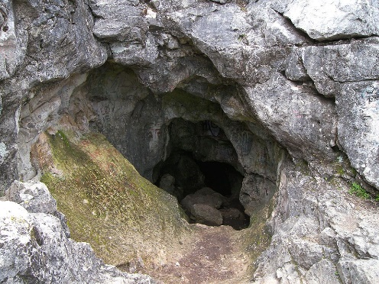
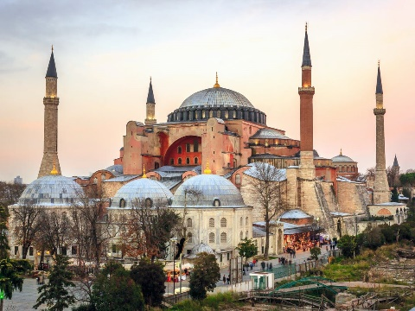
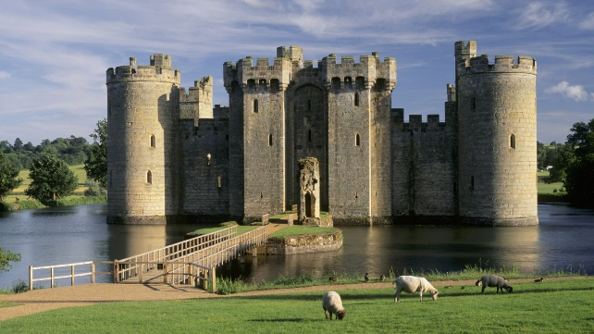

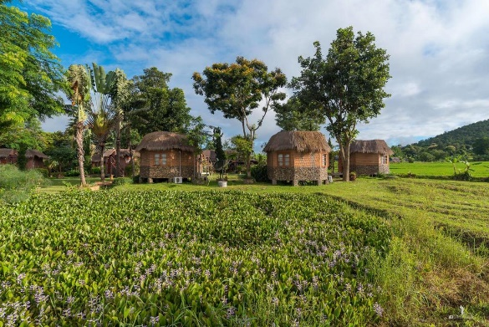
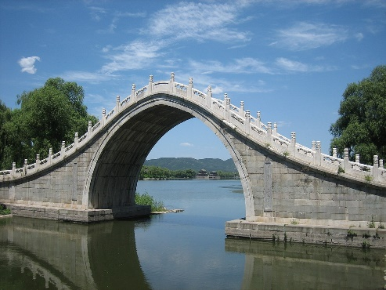
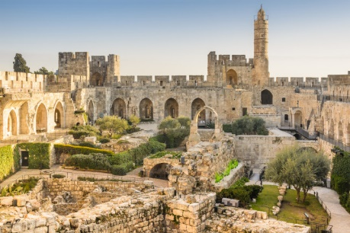
GÖRSELLER EKLENECEK
Vocabulary Exercises
2. Complete the sentences with the words below.
1. Write the words under the pictures.
ancient
all-inclusive
cultural
avoid
ancient city
countryside
bridge
old fashioned
natural
worldwide
southern
mosque
cave
castle
1. Efes is a real _________ city. Its history dates back to 6000 B.C.
2. To experience a fascinating ___________ holiday you should definitely go to Şanlıurfa.
3. I stayed in a / an _____________ hotel. It offers both accommodation and catering.
4. There is a _____________ carnival in Spain every year. It attracts many tourists.
5. With its natural beauties and ________________climate, Lisbon is one of the most fascinating places to see.
6. Black Sea region is famous for its_____________ beauties.
ancient
1.
3.
cultural
2.
Nartest İngilizce
all-inclusive
cave
mosque
castle
___________
___________
___________
4.
5.
6.
worldwide
warm
ancient city
countryside
bridge
___________
___________
___________
natural

Slide 7

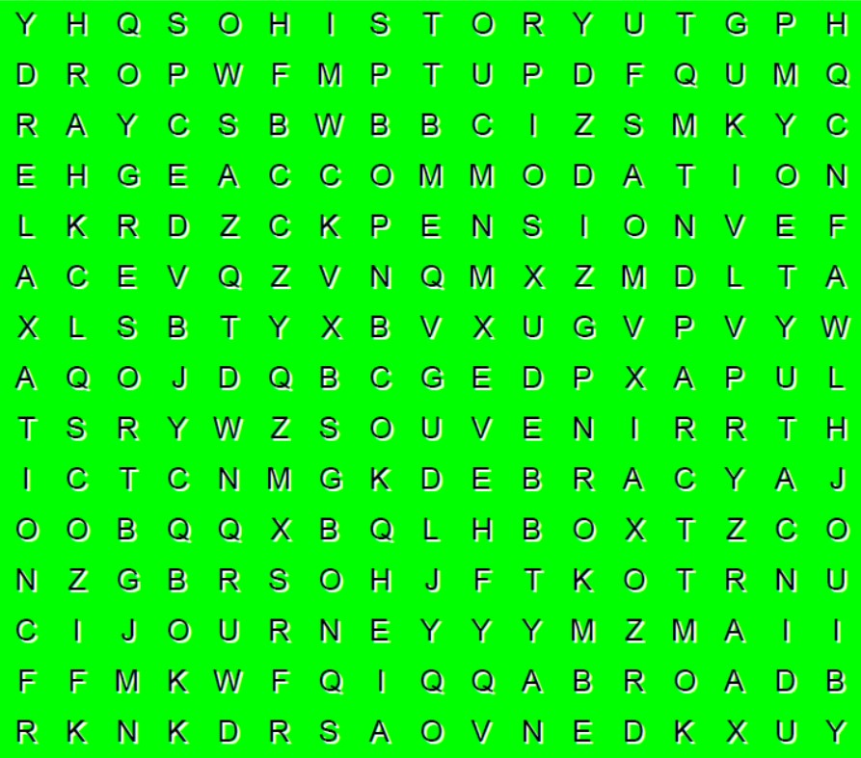

3. Match the halves of the phrases.
5. Find the 8 words in the word-search puzzle below.
7.
1. historical ___ a) vacation
2. tourist ___ b) hotel
3. open ___ c) history
4. boutique ___ d) beauty
5. living ___ e) architecture
6. natural ___ f) attraction
7. summer ___ g) area
4.
5.
6.
1.
2.
3.
Nartest İngilizce
4. Circle the correct options to complete the sentences.
1. I have visited a historic price / province in Spain.
2. There are different meetings / means of transportation in the city.
3. The weather / climate was rainy all the time.
4. This rock / route will take you right to the city centre.
5. Marie decided to go abroad / holiday for a vacation.
6. I have been to Tanzania before for a souvenir / safari holiday.

Slide 8
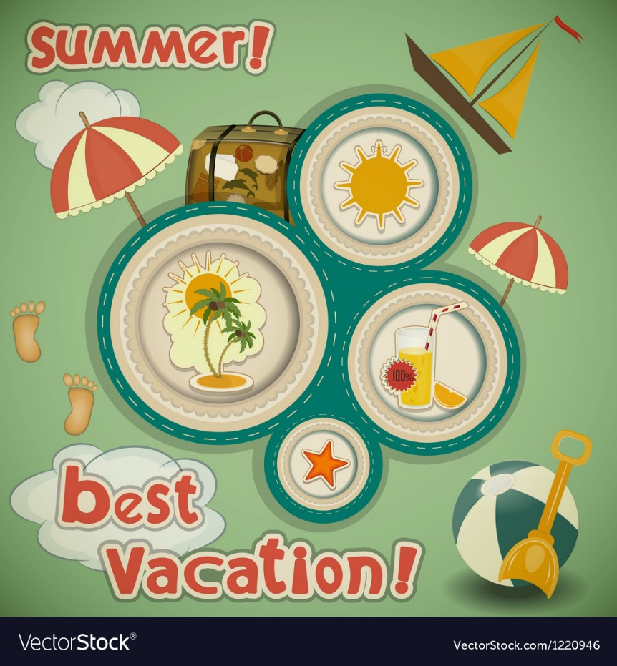
GRAMMAR
Giving Explanations and Reasons
We use ‘in my opinion’, ‘to me’, ‘I suppose’, ‘I guess’, ‘I believe’ to express our ideas on something.
What do you think about London?
To me / In my opinion, it is a fascinating city.
I think / believe / suppose / guess it looks incredible.
What does she think about Gökçeada?
In her opinion / To her, it is wonderful.
She thinks / guesses / supposes / believes the scenery was great.
What does he think about Istanbul?
To him / In his opinion, it is a magnificent city.
He thinks / guesses / supposes / believes the fried fish sandwich was delicious.
What do they think about rural places?
They think / guess / suppose / believe villages are more beautiful than cities.
In their opinion / To them , urban places are more fascinating than rural areas.

Slide 9
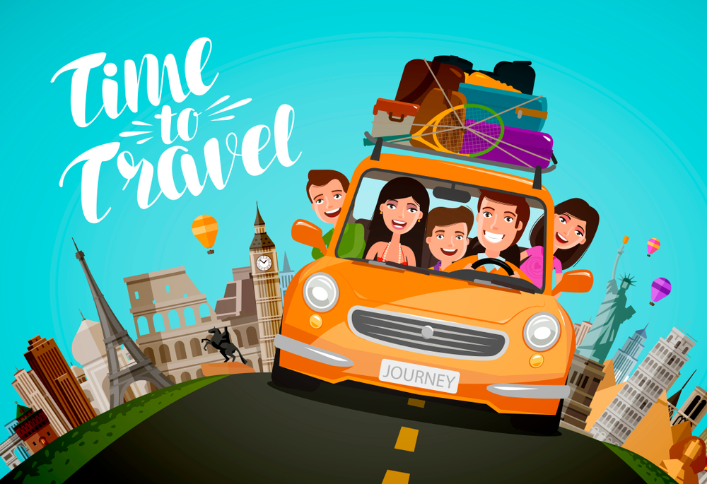
Making Comparisons
Affirmative
Negative
I | am | shorter | than Alice.
We You They | are
He She It | is
I | am not | shorter | than Alice.
We You They | aren’t
He She It | isn’t
Question
Am | I | shorter | than Alice?
Are | we you they
Is | he she it

Slide 10
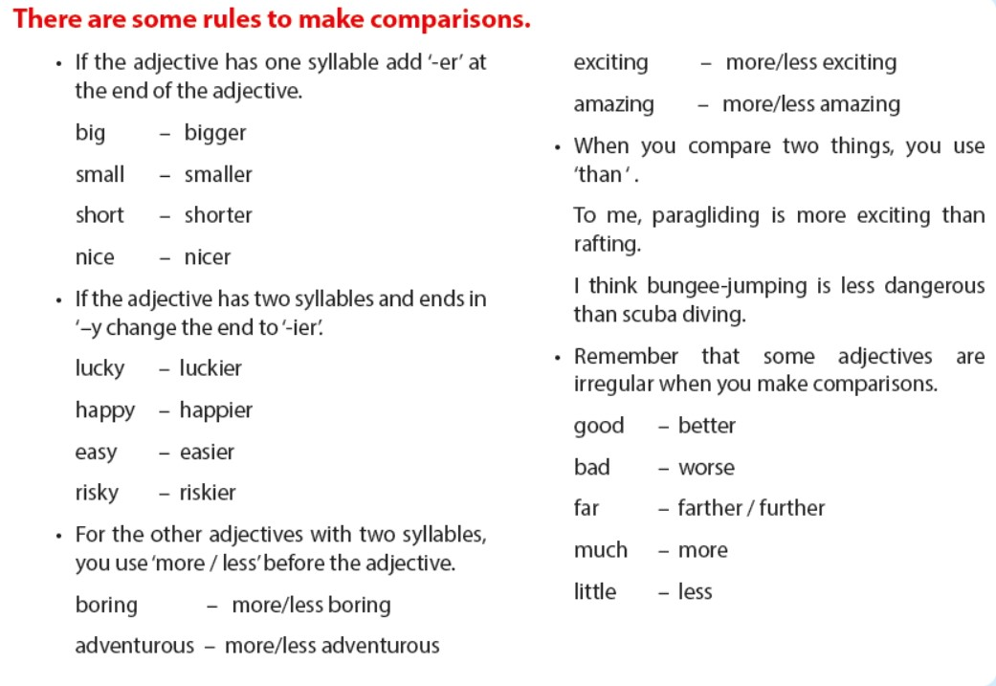

Slide 11

EXERCISES
1. Circle the correct options to complete the sentences.
1. Will : What does / do you think about New Jersey?
Jim : In my opinion / I guesses New Jersey is an incredible city.
2. Drake : Is Samsun more beautiful / beautiful than Konya?
Zach : I am interested in natural beauties so Samsun is more charming / charminger to me.
3. The weather is better / more good in Hatay today.
4. Kylie thinks / think historical places are more attractive.
5. I would rather live in urban places because they are more modern / moderner than rural places.

Slide 12
2.Put the sentences into the correct order.
1. tourist attractions / than / Selanik has / Mumbai / more.
____________________________________________
2. she / holidays / believes / amazing / cultural / are.
___________________________________________________
3. is / more / than Dorothy / successful / Marta.
______________________________________
4. opinion / rural / are / places / in / attractive / her.
______________________________________________
5. about / think / what / does / he / cruise holidays?
______________________________________
6. cheaper / boutique / are / hotels / than all inclusive hotels.
__________________________________________________
7. guess / historical / I / places / worth seeing / are.
_____________________________________________
3. Find and correct the mistakes in the sentences below.
Selanik has more tourist attractions than Mumbai.
1. Five-star hotels are expensiver than others.
_________________________________________
2. What does Kylie thinks about ancient cities?
_________________________________________
3. She believes Hatay is attractive than her city.
_________________________________________
4. Alison think the city is incredible.
_________________________________________
5. At my opinion, seaside hotels are incredible.
_________________________________________
She believes cultural holidays are amazing.
more expensive
Marta is more successful than Dorothy.
Nartest İngilizce
think
In her opinion, rural places are attractive.
more attractive
What does he think about cruise holidays?
thinks
Boutique hotels are cheaper than all inclusive hotels.
In
I guess historical places are worth seeing.

Slide 13
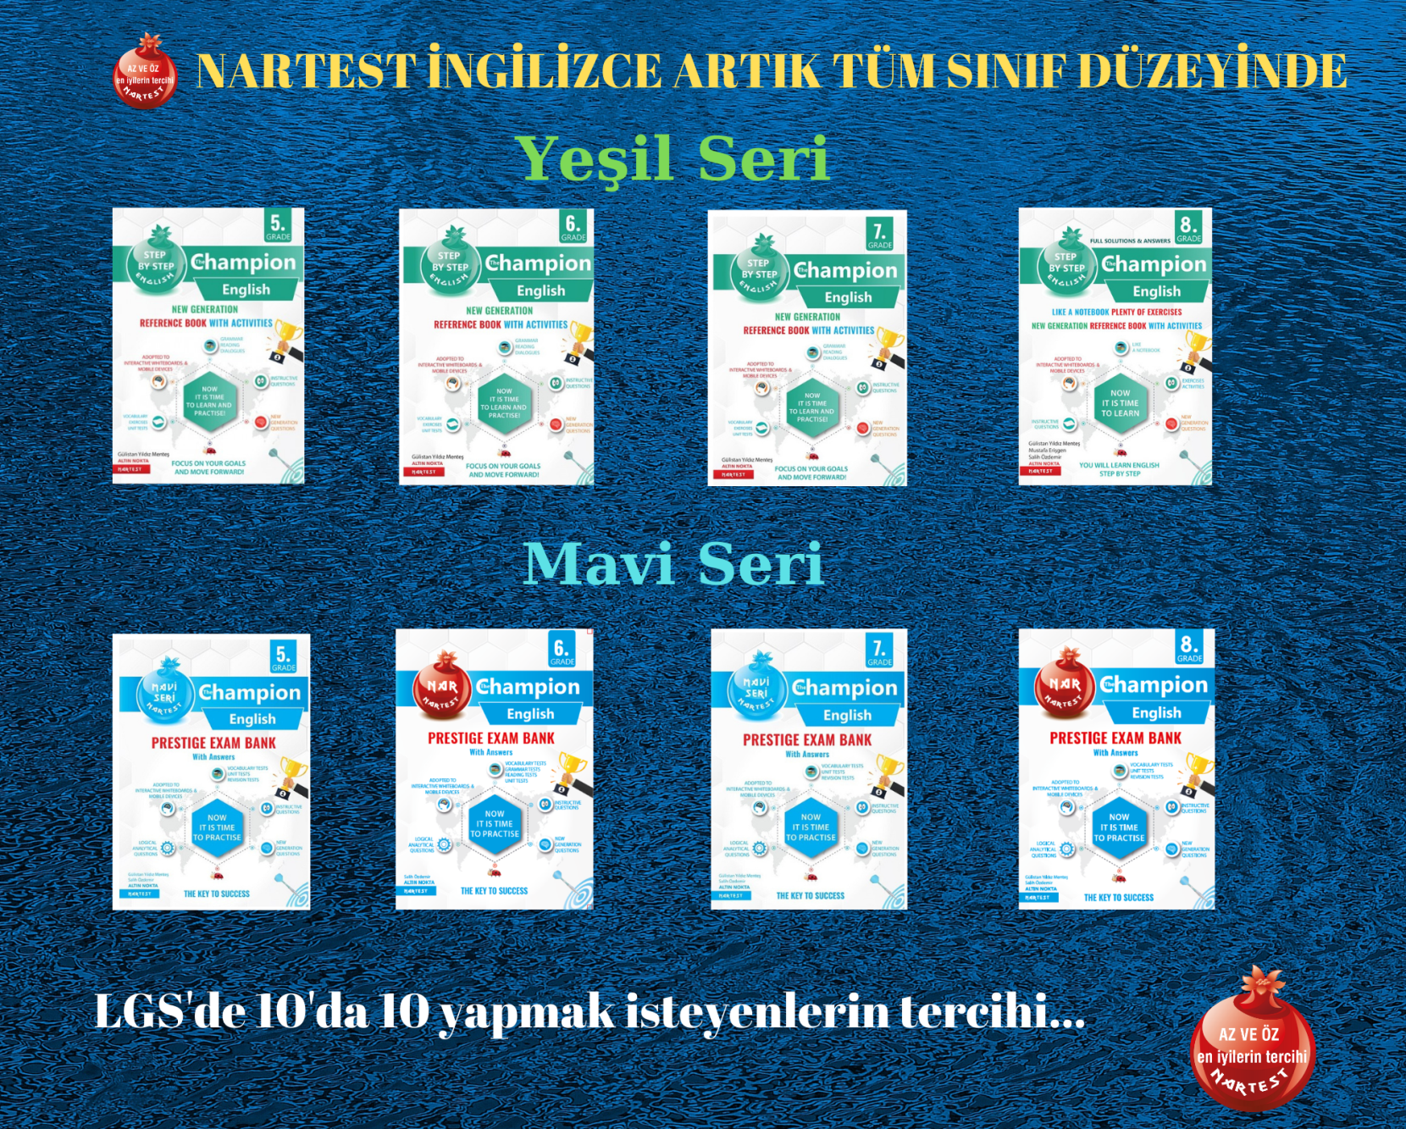
NARTEST İNGİLİZCE KALİTESİNE DAHA FAZLA ULAŞMAK İÇİN
www.altinkarne.com Sitemizden Kitaplarımızın PDF hallerine, Akıllı Tahta Uygulamalarına ve Ücretsiz Birçok Dokümana Ulaşabilirsiniz.

